Slide 1

DC-DC Converter for PV Module Integration
Group 760

Slide 2

CONTENT
INTRODUCTION
CONVERTER DESIGN
MPPT ALGORITHM
TESTS RESULTS
DISCUSSION
CONCLUSION

Slide 3
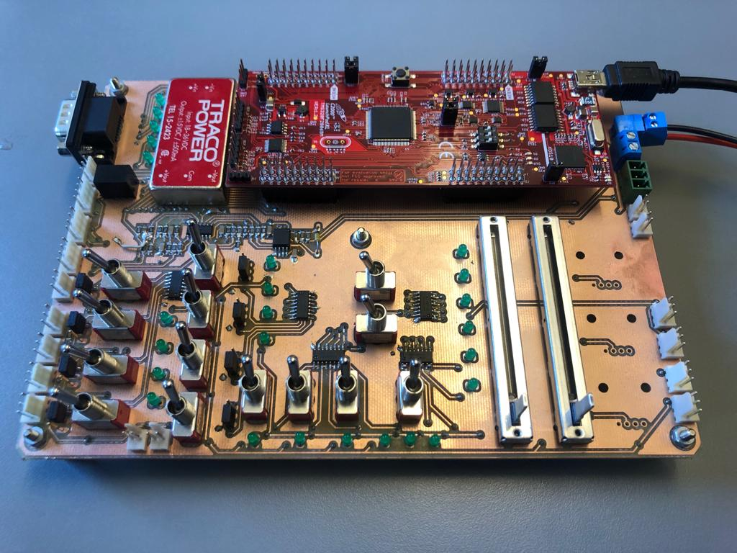
Hardware
Notes:
Motivation
Existing problems
What is a MIC
Why a MIC
Problem statement

Slide 4
Interface Board
Slide
of 59
Sections of board
Power supply
DSP development kit
Reference selection
UART connection with PC
Top-view of Interface board with DSP kit

Slide 5
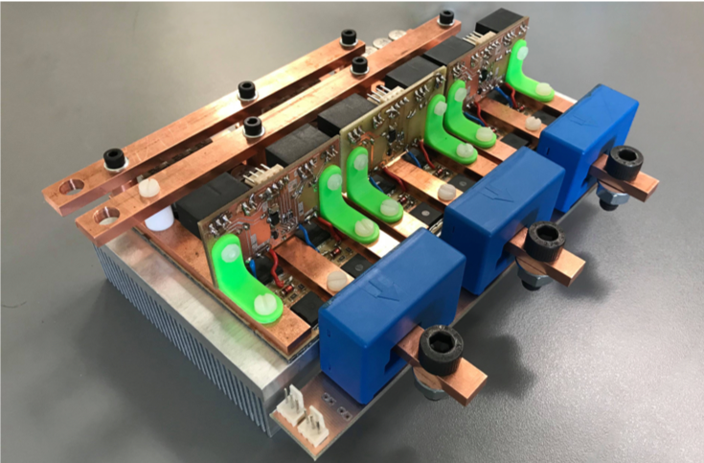
Inverter
Slide
of 59
Inverter Electrical Characteristics
Power capability : 7.3kW
DC link voltage : 35V
Switching frequency : 20kHz
MOSFET Used
Infineon OptiMOSTM : 80V 300A
Package type : PG-HSOF-8-1
Max. allowed T_{j} : 175℃
3phase Inverter with Current Sensor

Slide 6
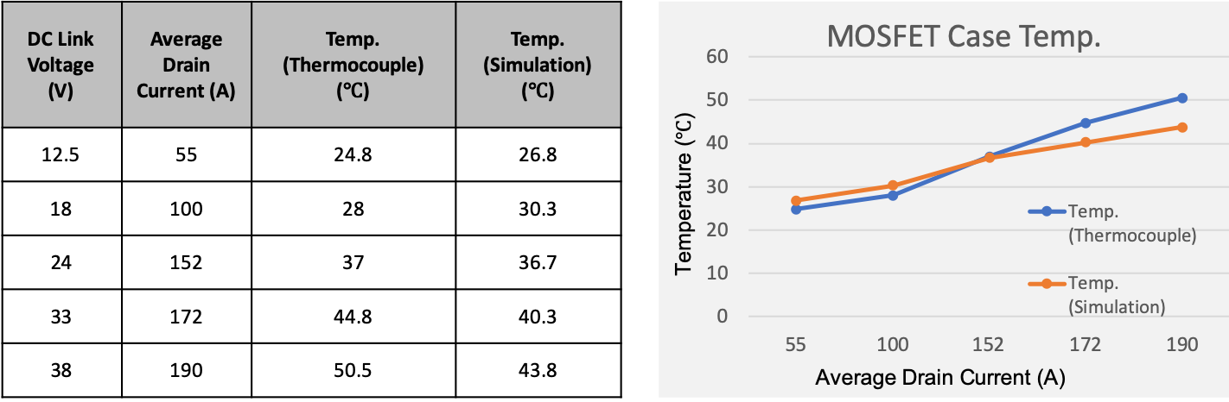
Inverter thermal test
Slide
of 59
Inverter case temperature test at different operating condition upto rated values

Slide 7
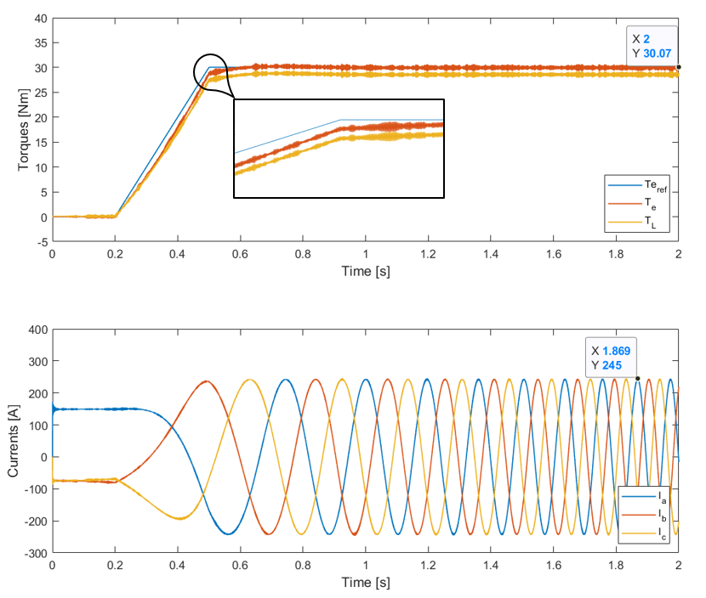
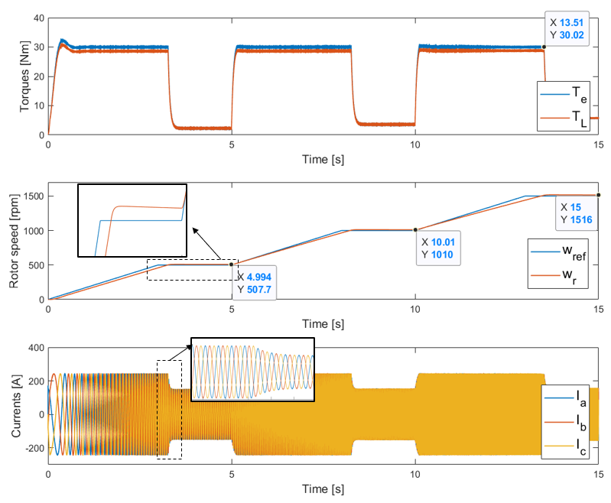
Simulation result
Slide
of 59
Torque Control
Speed Control

Slide 8
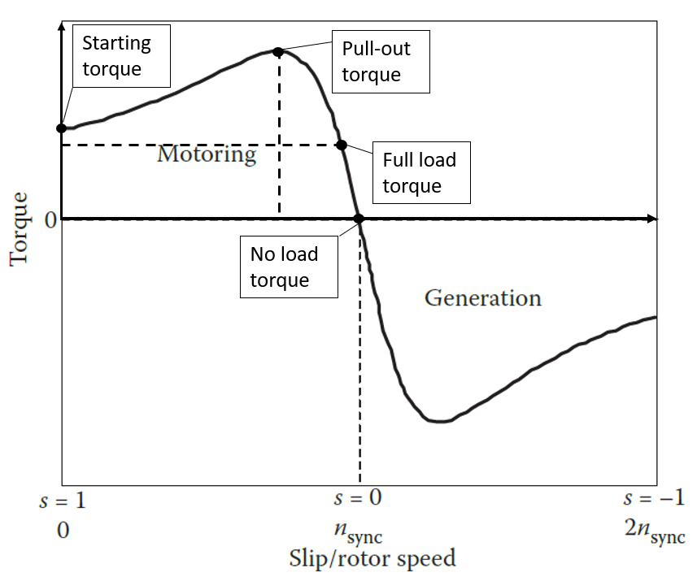


Regenerative braking
Slide
of 59
When the rotor speed is higher than synchronous speed (i.e., negative slip), the machine runs in generation mode.
$slip= \frac{n_{sync} − n_{rotor}}{n_{sync}}$
$$n_{rotor}> n_{sync}$$
Negative slip
Negative torque

Slide 9
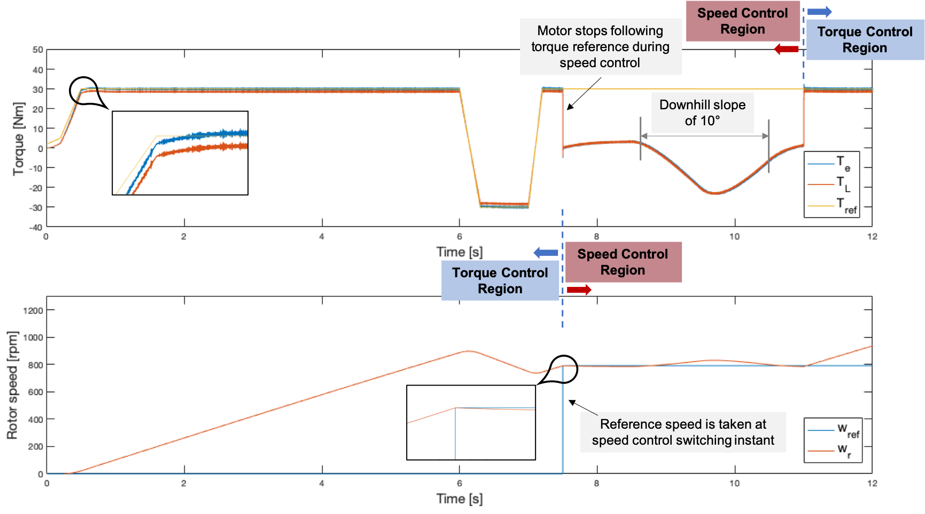
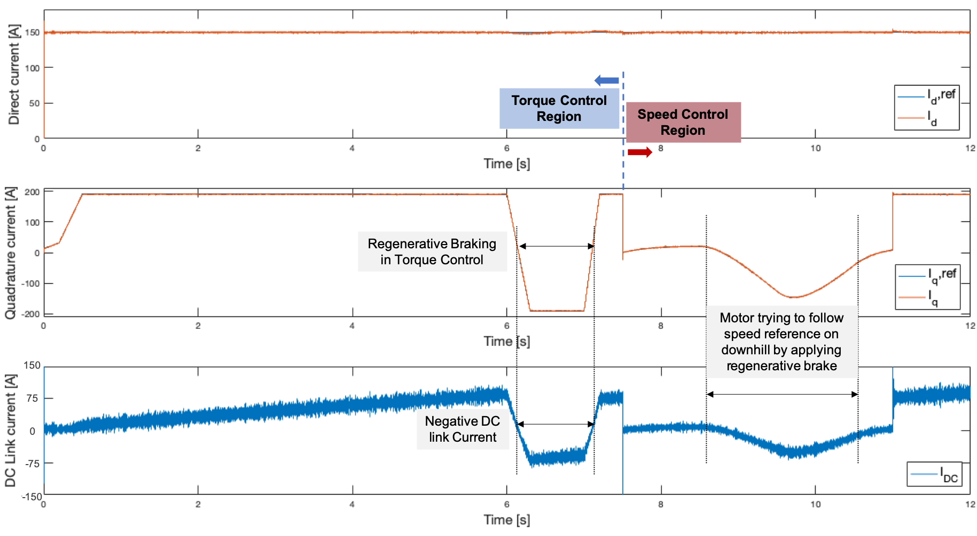
Regenrative braking simulation
Slide
of 59

